Slide 1

Major Project Presentation
An Interactive Real-Time System for Tracking and Analyzing Weather and Pollution Patterns
Page - 1
Presented by:
Sandip Kundu – 27600122033
Aditya Shee – 27600122107
Rajan Mandal – 27600122144
Aniket Kumar – 27600122147
Pranab Kumar Ghosh – 27600122206
Supervisor: Prof. Sagar Chakraborty
Department of Computer Science & Engineering
Budge Budge Institute of Technology, Kolkata
20 July , 2026

Slide 2

Objective
Page - 2
Most existing weather and air quality applications provide only real-time data — they lack historical analysis, forecasting, and collaborative features within a single platform, forcing users to depend on multiple separate applications for complete environmental information.
The objective of ClimaSphere is to provide a unified platform for real-time weather monitoring, air quality analysis, and environmental forecasting — addressing these limitations by integrating real-time data, historical analysis, predictive insights, knowledge sharing, and collaborative features into a single application. It is designed to assist the general public, students, scientist, researchers, environmental analysts, educators, NGOs, government agencies, and environmental activists in understanding environmental conditions, promoting awareness, supporting research, and making informed, data-driven decisions.

Slide 3
Page - 3
ABSTRACT
ClimaSphere is a full-stack web-based environmental intelligence platform developed using the MERN Stack (MongoDB, Express.js, React.js, and Node.js). The system integrates the OpenWeather Weather API and Air Pollution API to provide real-time monitoring of temperature, humidity, wind speed, AQI, PM2.5, PM10, NO₂, SO₂, and CO for locations worldwide. Historical datasets from 20+ Indian cities are analysed using Python for Exploratory Data Analysis and trend identification. Prophet-based forecasting predicts future AQI and weather conditions, deployed via Streamlit. Authenticated users can publish analytical insights, download CSV datasets, and collaborate through community chat, voice calls, and social blogging, making ClimaSphere a unified platform for environmental monitoring, analysis, and awareness.

Slide 4
Page - 4
COMPARATIVE TABLE
Feature | Google Weather | IQAir | OpenWeather | Govt Portals | ClimaSphere
Real-time Weather Data | ✅ Yes | ❌ Limited | ✅ Yes | ❌ No | ✅ Yes
Real-time AQI Data | ❌ Limited | ✅ Yes | ✅ Yes | ✅ Yes | ✅ Yes
Weather + AQI Single Platform | ❌ No | ❌ Limited | ✅ Yes | ❌ No | ✅ Yes
AQI Based on Multiple Pollutants | ❌ No | ✅ Yes | ✅ Yes | ✅ Yes | ✅ Yes
Historical Data Access | ❌ No | ❌ Limited | ⚠️ API Only | ✅ Yes | ✅ Yes
CSV Data Download | ❌ No | ❌ No | ⚠️ API Only | ❌ Limited | ✅ Yes
Exploratory Data Analysis (EDA) | ❌ No | ❌ No | ❌ No | ❌ No | ✅ Yes
AQI Forecasting | ❌ No | ❌ Limited | ❌ No | ❌ No | ✅ Yes
Weather Forecasting | ✅ Yes | ❌ Limited | ✅ Yes | ❌ Limited | ✅ Yes
Analysis & Insights Repository | ❌ No | ❌ No | ❌ No | ❌ No | ✅ Yes
Community Chat & Collaboration | ❌ No | ❌ No | ❌ No | ❌ No | ✅ Yes
User Authentication & Profiles | ❌ Limited | ✅ Yes | ⚠️ API Only | ❌ No | ✅ Yes
Student / Research Platform | ❌ No | ❌ No | ❌ No | ❌ No | ✅ Yes

Slide 5
Page - 5
LITERATURE REVIEW
Environmental monitoring has become a critical research area due to rising concerns about climate change, urbanization, and air pollution. Recent studies by Grech et al. (2024) and Chadalavada et al. (2025) highlight that while modern platforms provide real-time data and AI-based forecasting, most suffer from fragmented features — focusing either on monitoring or prediction, rarely combining both within a single system. Existing platforms such as IQair, OpenWeather, Windy, and AccuWeather primarily serve specific functionalities like weather display or AQI reporting. They lack analytical & insights repository, historical data exploration, research collaboration, and knowledge-sharing capabilities — forcing users to switch between multiple platforms for complete environmental information. ClimaSphere addresses this gap by combining real-time monitoring, Exploratory Data Analysis, Prophet-based forecasting, an Analysis and Insights Repository, and community collaboration into a single unified web-based platform.

Slide 6

USED TECH STACK
Page - 6
Frontend: React.js v19, Tailwind CSS v4, Chart.js, Vite v7
Backend: Node.js v22, Express.js v5
Database: MongoDB v8, Mongoose v8
Real-Time Communication: Socket.IO v4 (Chat, Notifications)
Authentication & Security: JWT (JSON Web Token), bcrypt
Media Storage: Cloudinary SDK v2, Multer v2
Python & ML Libraries: Pandas, NumPy, Matplotlib, Seaborn, Poltly, Scikit-learn, Prophet Model, Joblib
Forecasting Deployment: Streamlit (AQI & Weather Forecasting Apps)
Frontend Deployment: Vercel
Development Tools: Postman, Git, GitHub, VS Code, Jupyter Notebook

Slide 7
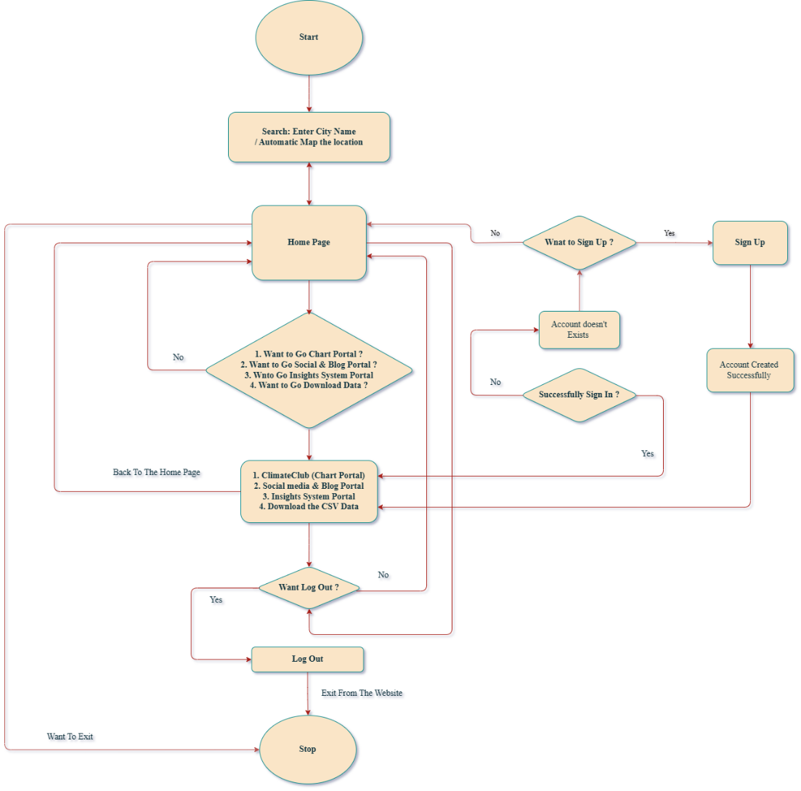
Flow Chart of System Architecture
PROPOSED APPROACH
Page - 7
Step 1 — User Authentication: JWT-secured login, registration, and role-based access control (User / Analyst / Admin)
Step 2 — Environmental Data Acquisition: City search or auto-location detection → OpenWeather Weather API fetches live data → coordinates used to call Air Pollution API
Step 3 — Data Processing & Storage: Weather and AQI responses merged, validated, and stored in MongoDB
Step 4 — Real-Time Dashboard: Processed data displayed via React.js with interactive charts using Chart.js
Step 5 — Historical Data & EDA: Historical Indian city datasets analysed using Python (Pandas, Seaborn, Matplotlib)
Step 6 — Forecasting: Prophet model generates AQI and weather forecasts, deployed via Streamlit.
Step 7 — Insights & Collaboration: Analysts publish findings via Analysis & Insights Repository; users collaborate through chat, and blogging
Step 8 — Alerts & Notifications: Real-time weather alerts and AQI notifications delivered to users via Socket.IO

Slide 8
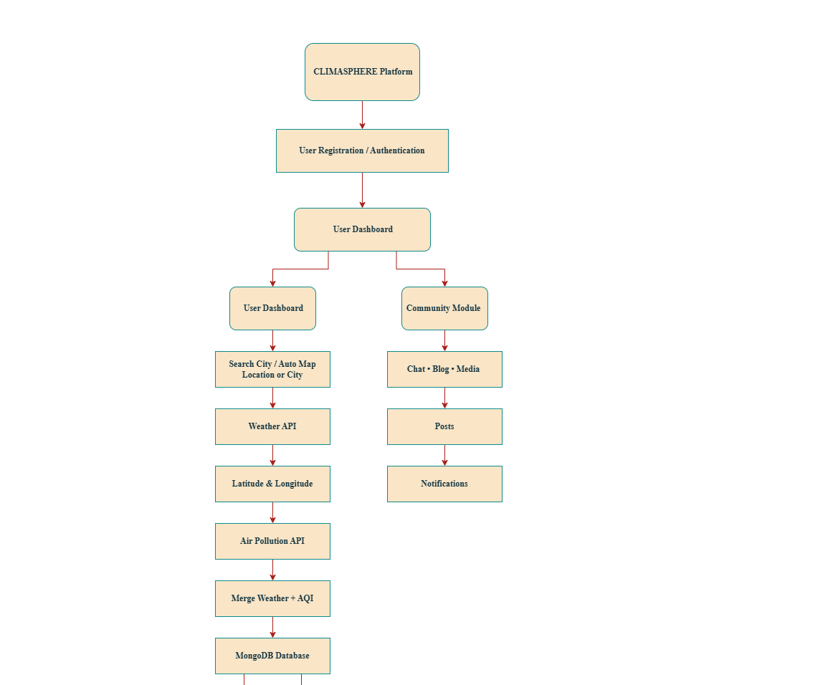
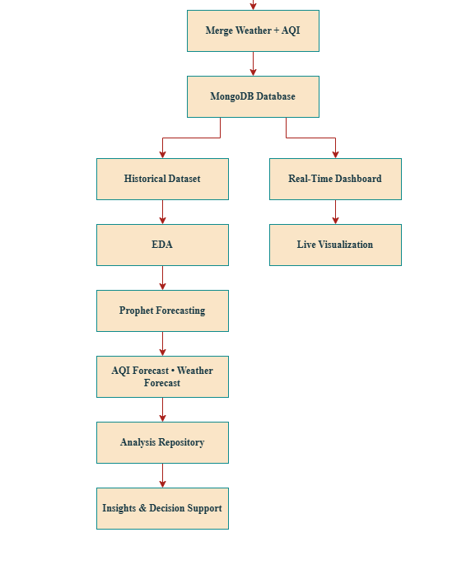
Page - 8
Flow Chart of System Development

Slide 9
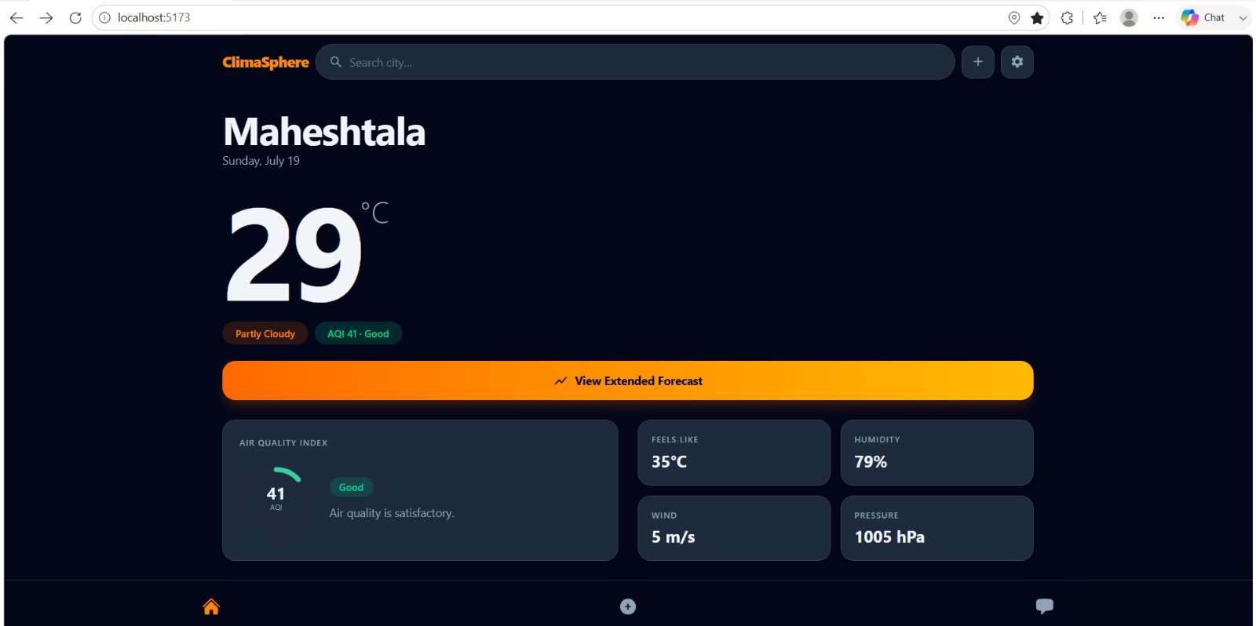
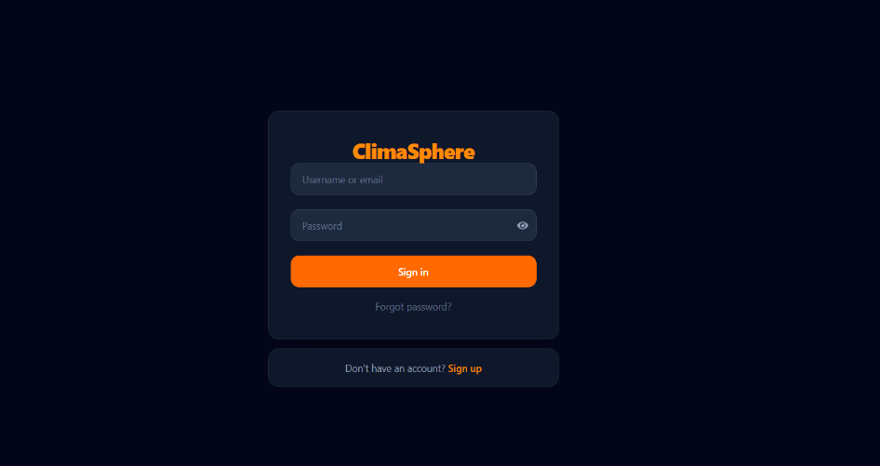
Page - 9
OVERVIEW OF USER INTERFACE
Home Page
Sign in & Sign up page

Slide 10

Page - 10
CHART SYSTEM

Slide 11
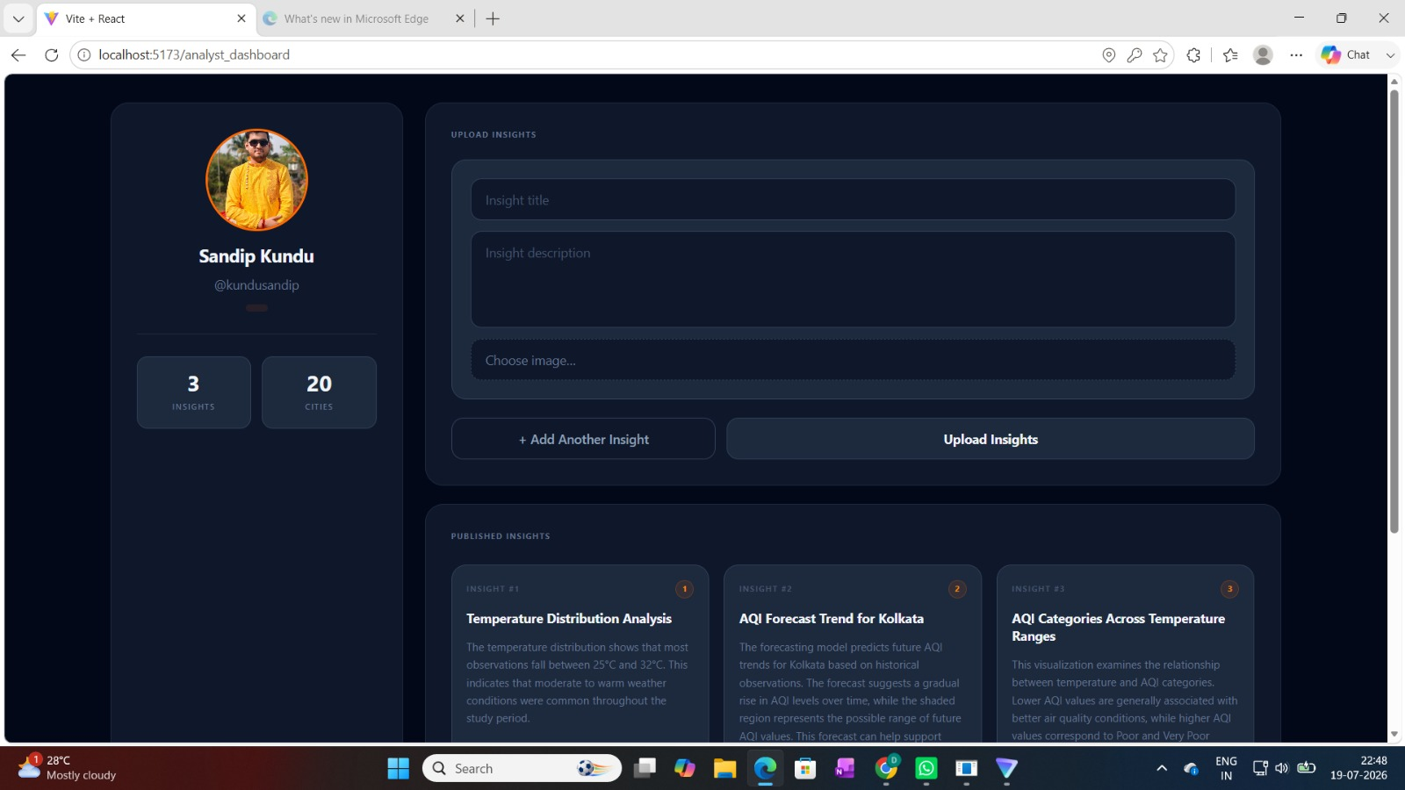
Page - 11
ANALYST REPOAITORY

Slide 12
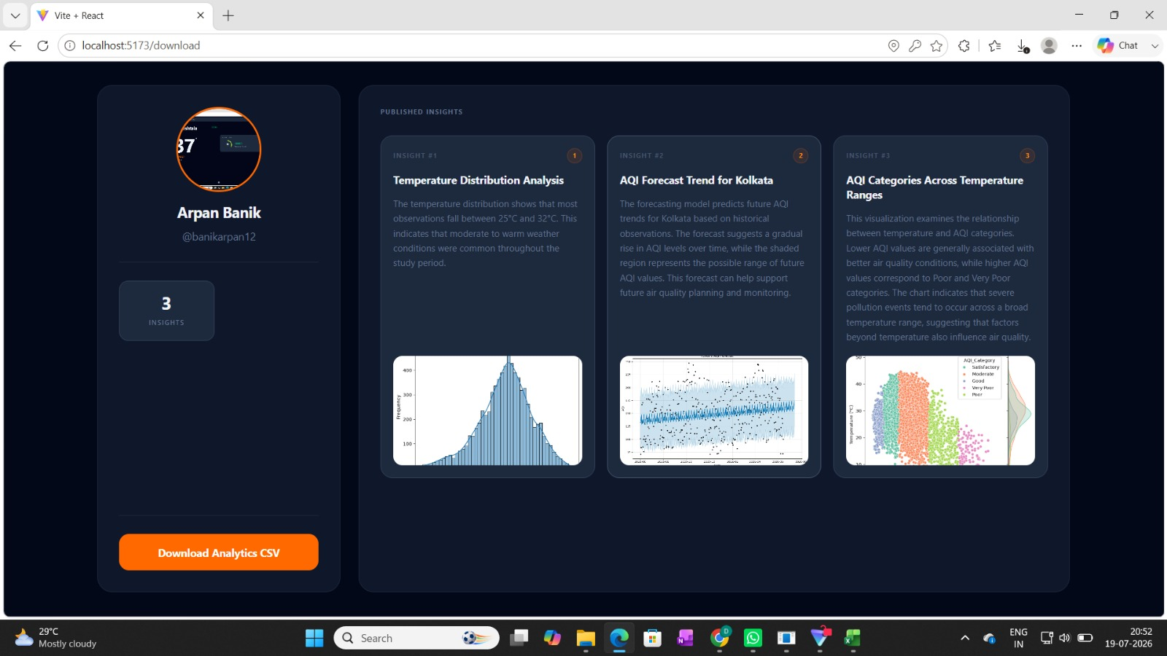
Page - 12
ANALYSIS & INSIGHTS REPOAITORY

Slide 13
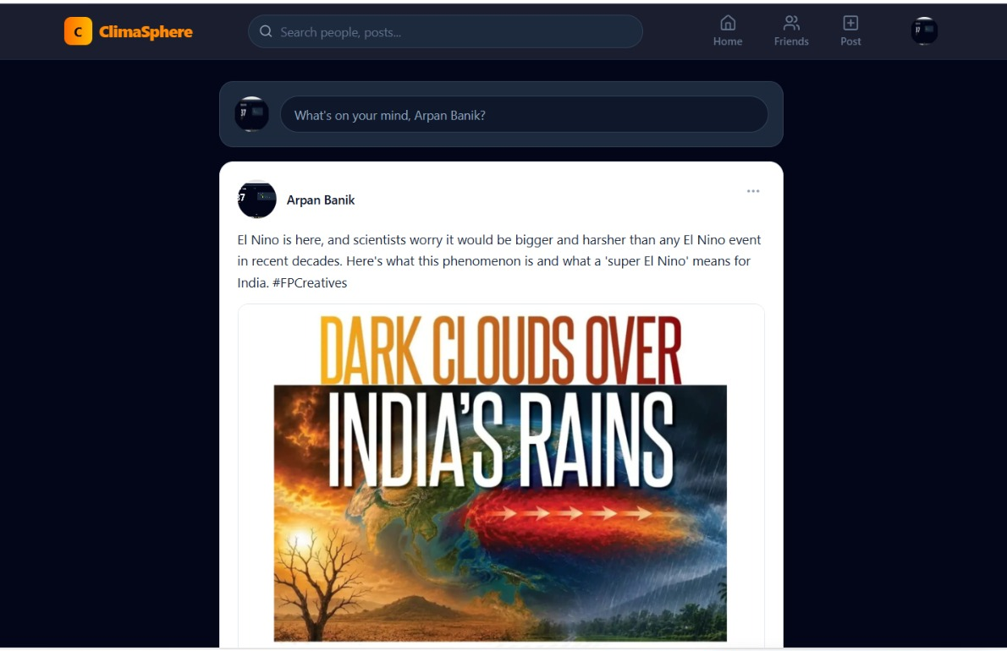
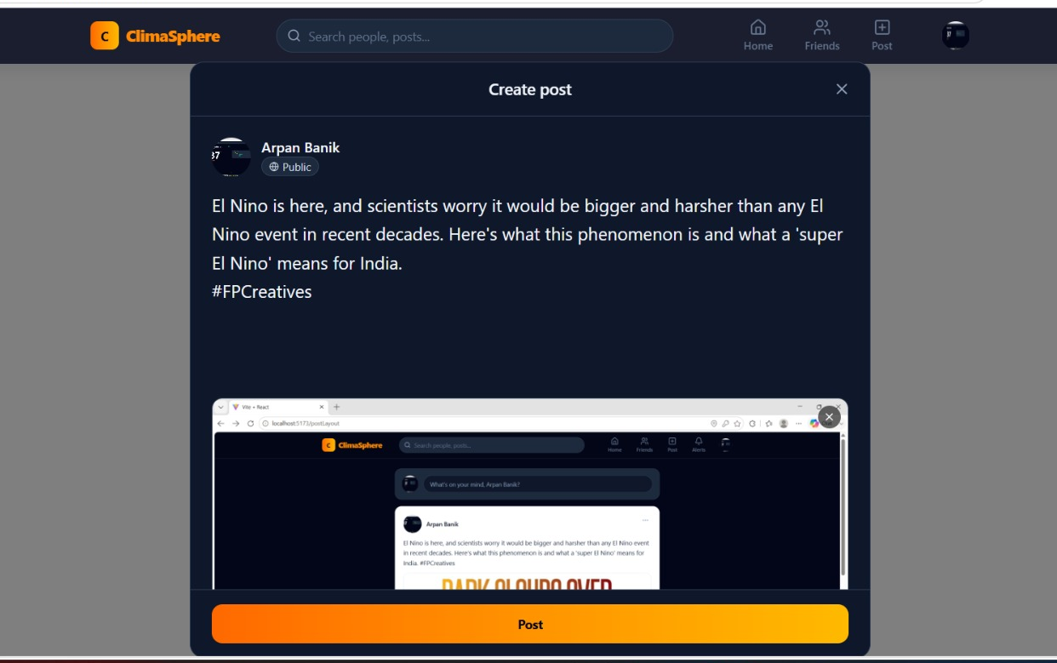
Page - 13
SOCIAL MEDIA & BLOG MODULE

Slide 14
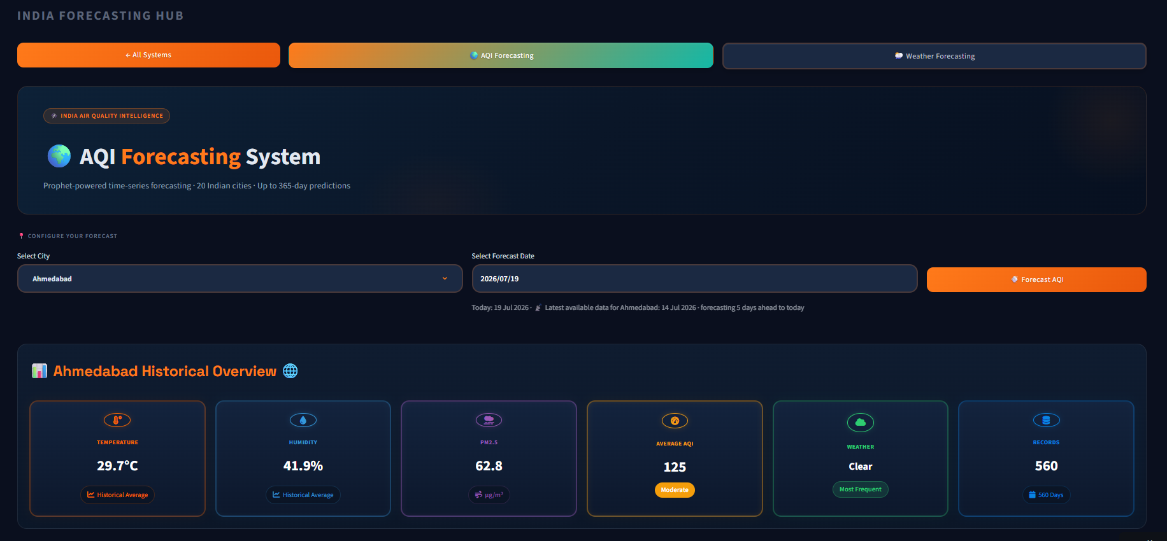
Page - 14
AQI FORECASTING SYSTEM

Slide 15
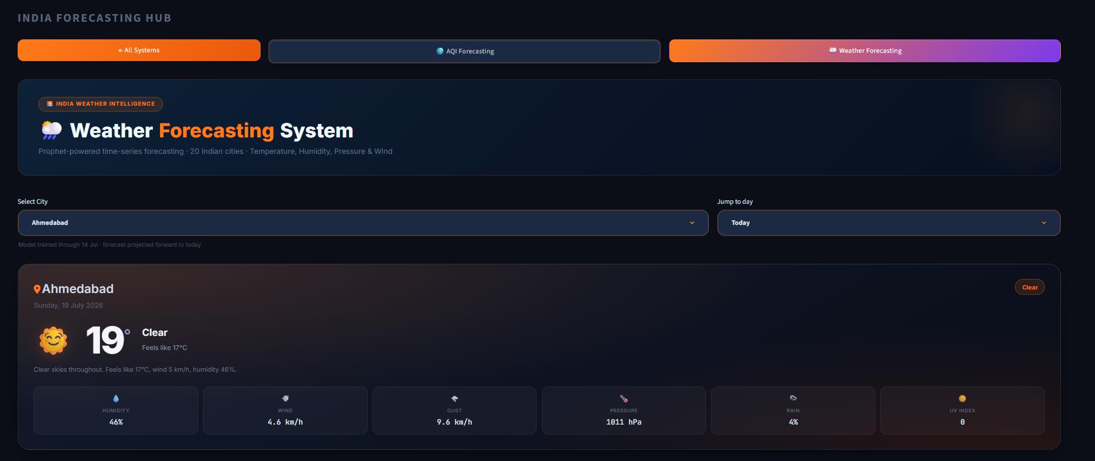
Page - 15
WEATHER FORECASTING SYSTEM

Slide 16
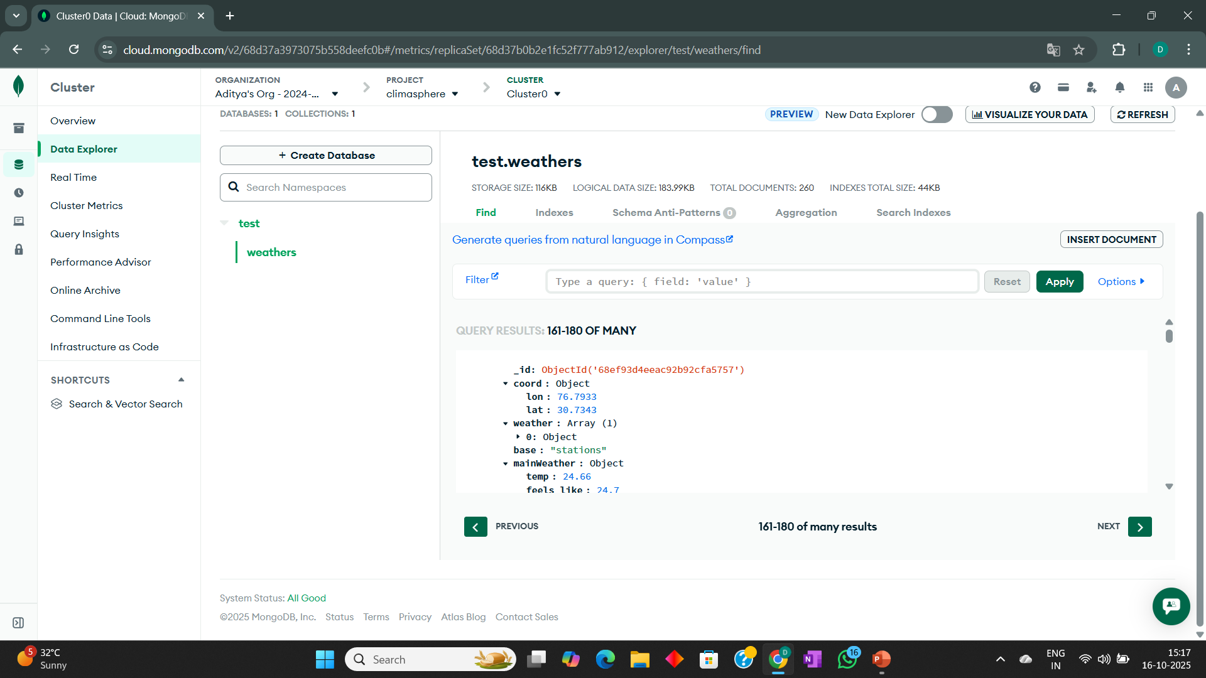
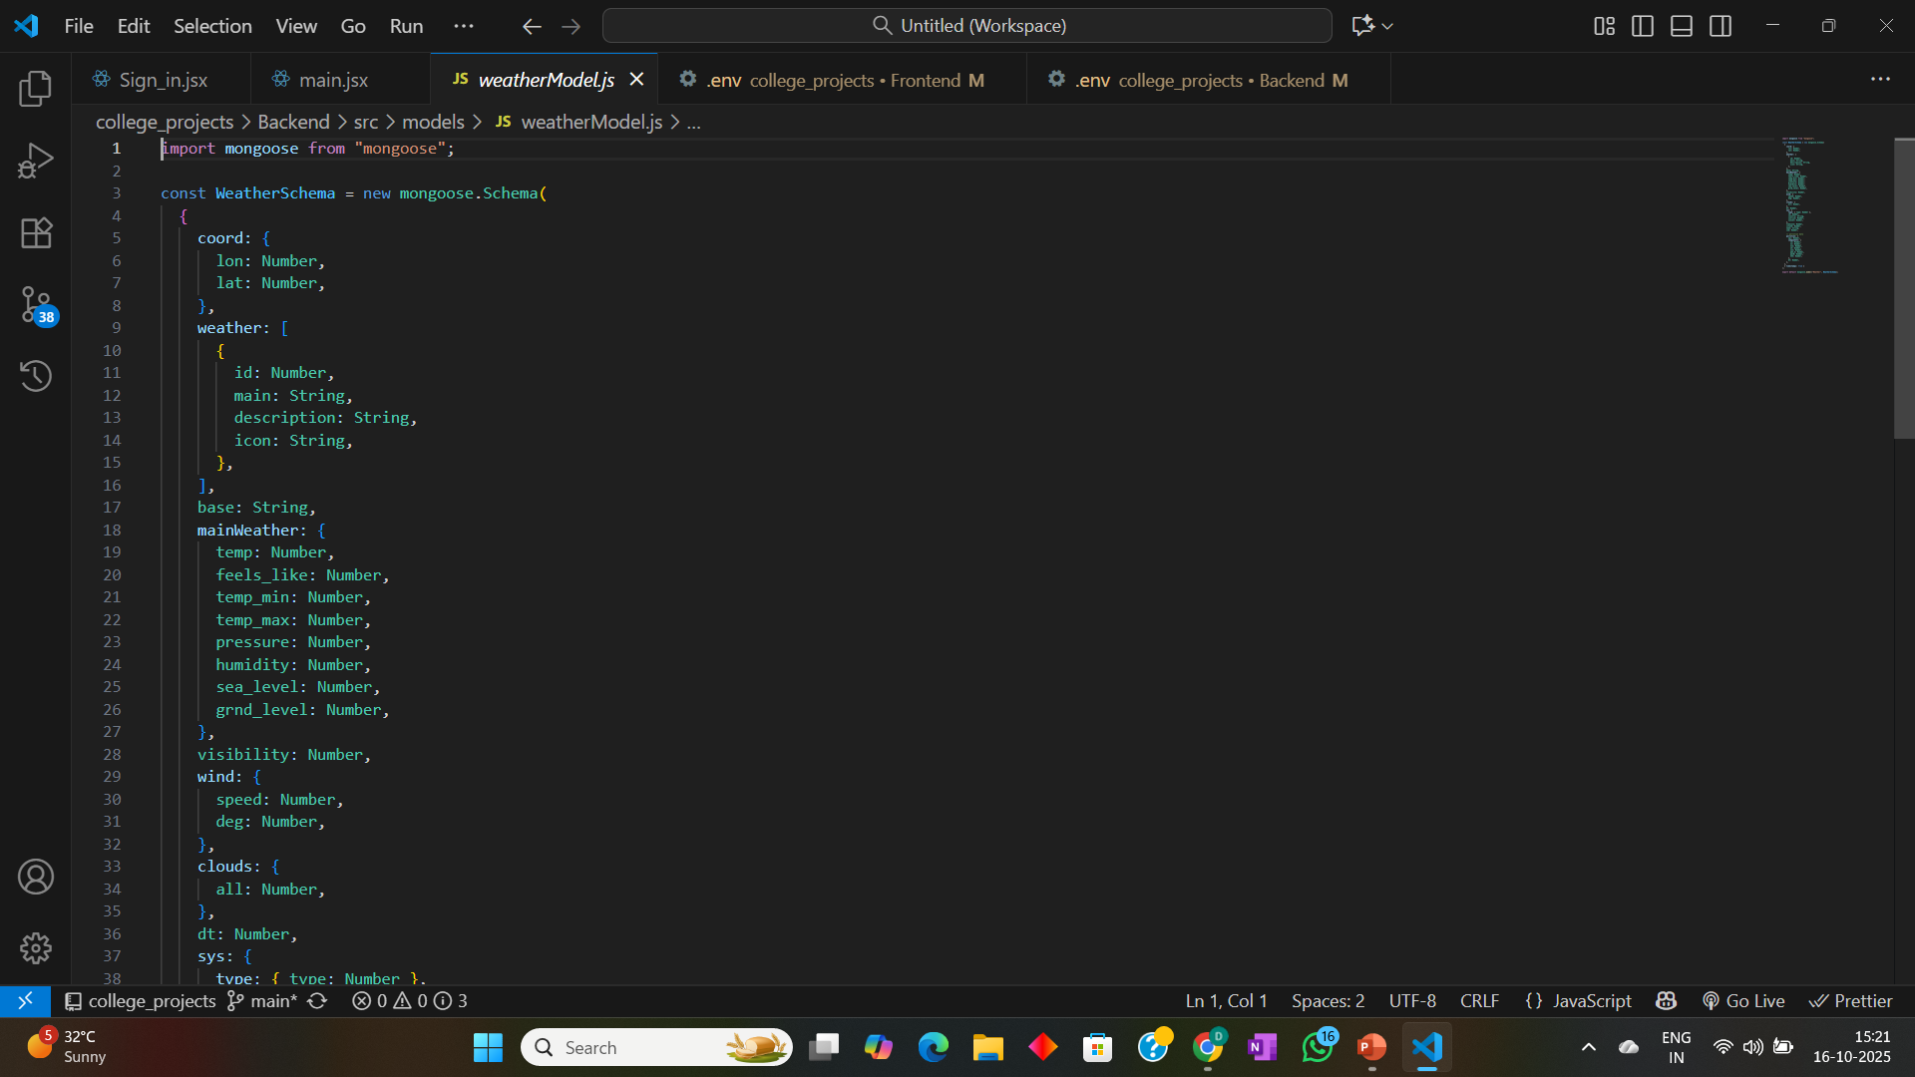
Page - 16
OVERVIEW OF BACKEND SURFACE
Location wise database of weather and pollution data
Mongoose schema of weather and pollution data

Slide 17
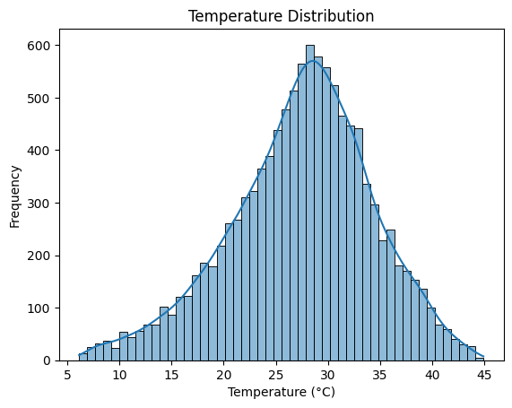
Page - 17
EXPLORATORY DATA ANALYSIS
Weather Analysis: Temperature Distribution
Chart Type: Histogram with Kernel Density Estimation (KDE)
Description: The chart shows the distribution of temperature values (°C) across the dataset, indicating how frequently different temperature ranges occur.
Key Insights:
Most temperature values are concentrated between 24°C and 34°C.
The highest frequency occurs around 29°C–30°C, representing the most common temperature range.
Very low (<10°C) and very high (>40°C) temperatures occur rarely.
The smooth bell-shaped distribution indicates a consistent temperature pattern.

Slide 18
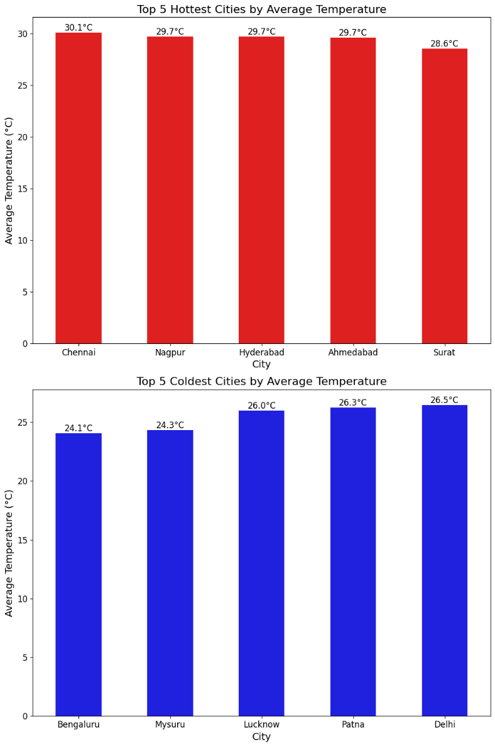
Weather Analysis: Top 5 Hottest & Coldest Cities
Page - 18
Chart: Top 5 Hottest & Coldest Cities by Average Temperature
Key Insights:
The bar charts compare the hottest and coldest cities by average temperature across the dataset. Chennai recorded the highest average temperature at 30.1°C, followed closely by Nagpur, Hyderabad, and Ahmedabad at 29.7°C each, and Surat at 28.6°C — with relatively small differences among the top five. On the other end, Bengaluru recorded the lowest average temperature at 24.1°C, followed by Mysuru (24.3°C) and Lucknow, Patna, and Delhi ranging between 26.0°C and 26.5°C. Overall, the temperature variation among both the hottest and coldest cities is relatively small, reflecting consistently warm climatic conditions across Indian cities with only moderate regional differences.

Slide 19
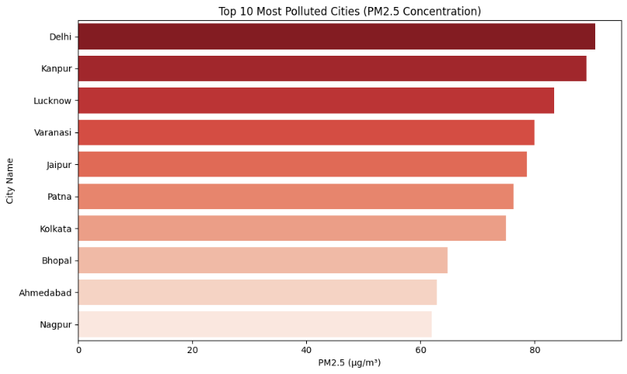
Page - 19
EXPLORATORY DATA ANALYSIS
Pollution Analysis: Temperature Distribution
Chart Type: Horizontal bar chart
Description: The chart displays the top 10 most polluted cities based on their average PM2.5 concentration (µg/m³), highlighting cities with the highest particulate matter levels.
Key Insights:
Delhi recorded the highest PM2.5 concentration, making it the most polluted city in the dataset.
Kanpur and Lucknow ranked second and third, respectively, with consistently high PM2.5 levels.
Varanasi, Jaipur, Patna, and Kolkata also recorded elevated PM2.5 concentrations.
Nagpur recorded the lowest PM2.5 concentration among the top 10 most polluted cities

Slide 20
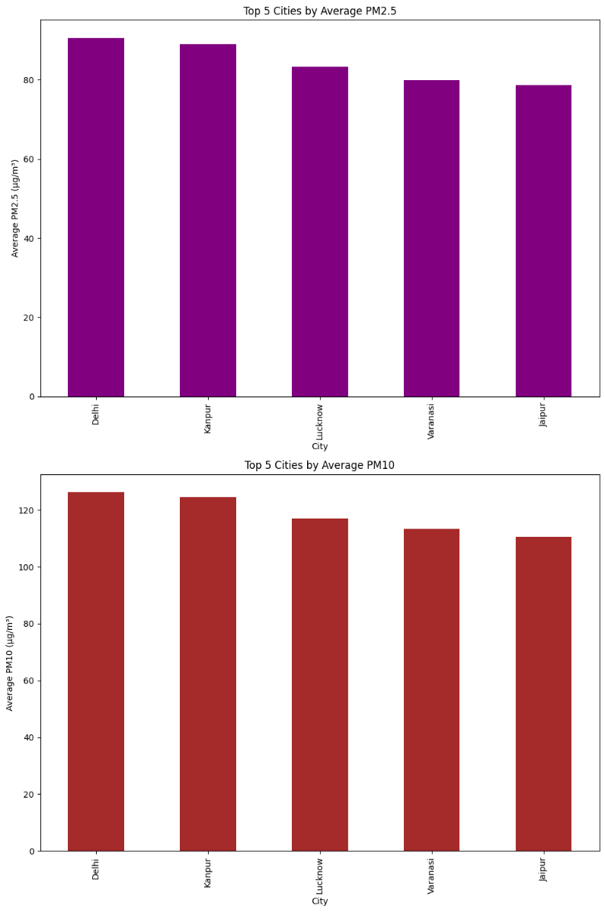
Page - 20
Pollution Analysis: Top 5 Cities by Avg. PM2.5 & PM10
Chart: Top 5 Cities by Average PM2.5 & PM10
Key Insights:
The charts illustrate the PM2.5 concentration levels across Indian cities and compare the top cities by average PM2.5 and PM10 particulate matter concentrations recorded in the dataset. Delhi recorded the highest PM2.5 concentration making it the most polluted city, followed by Kanpur and Lucknow in second and third positions respectively. Varanasi, Jaipur, Patna, and Kolkata also recorded elevated PM2.5 levels while Nagpur recorded the lowest among the top 10. The same ranking pattern is observed for PM10 concentrations — confirming a very strong positive relationship between PM2.5 and PM10 (correlation: 0.99). The temperature difference among the top polluted cities is relatively small, highlighting that northern Indian cities consistently experience the highest particulate matter pollution levels.

Slide 21
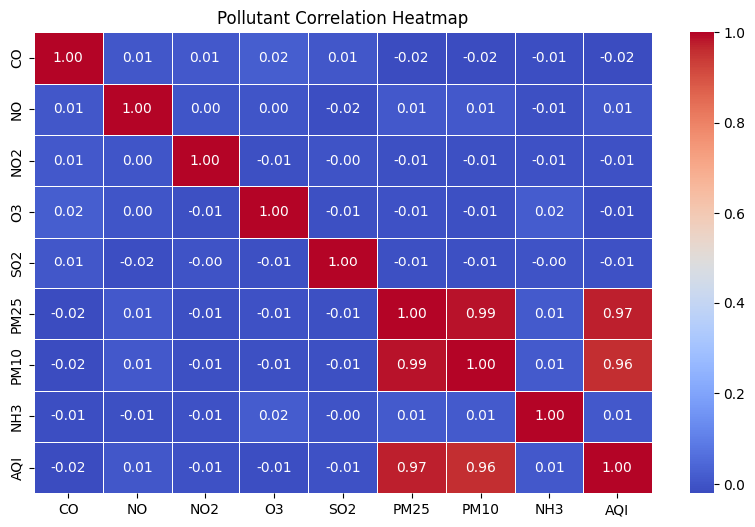
Page - 21
EXPLORATORY DATA ANALYSIS
AQI vs. Pollution Analysis: Pollutant Correlation Heatmap
Chart Type: Correlation heatmap
Description: The heatmap shows the correlation between major air pollutants and the AQI, indicating the strength of their linear relationships.
Key Insights:
PM2.5 and PM10 show a very strong positive correlation (0.99).
AQI has a strong positive correlation with PM2.5 (0.97) and PM10 (0.96).
CO, NO, NO₂, O₃, SO₂, and NH₃ exhibit negligible correlations with AQI and with each other.
Overall, the heatmap indicates that PM2.5 and PM10 are the pollutants most strongly associated with AQI.

Slide 22
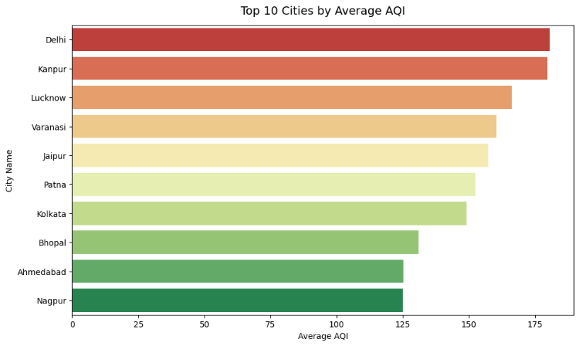
Page - 22
AQI vs. City Analysis: Top 10 Cities by Avg. AQI
Chart Type: Horizontal Bar Chart
Description: The chart displays the top 10 cities with the highest average AQI, highlighting the cities experiencing the poorest overall air quality.
Key Insights:
Delhi recorded the highest average AQI among all cities.
Kanpur ranked second, followed by Lucknow and Varanasi.
Jaipur, Patna, and Kolkata also recorded consistently high average AQI values.
Nagpur recorded the lowest average AQI among the top 10 cities.
Overall, the chart indicates that Delhi and Kanpur experience the highest average AQI levels.

Slide 23
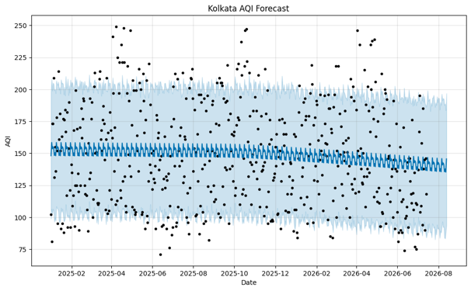
Page - 23
OVERVIEW OF MODEL OUTCOME
Chart Type: Time Series Forecast Plot (Prophet Model)
Description: The chart presents the forecasted AQI trend for Kolkata. The shaded region represents the forecast confidence interval.
Key Insights:
The forecast indicates a gradual decline in AQI levels over the prediction period.
Most observed AQI values lie within the forecast confidence interval, indicating a reasonable model fit.
The wider confidence interval in the forecast period reflects greater uncertainty in long-term AQI predictions.
Despite the declining trend, the forecast suggests that AQI levels are expected to remain within the moderate air quality range
AQI Forecast : AQI Forecast For Kolkata

Slide 24
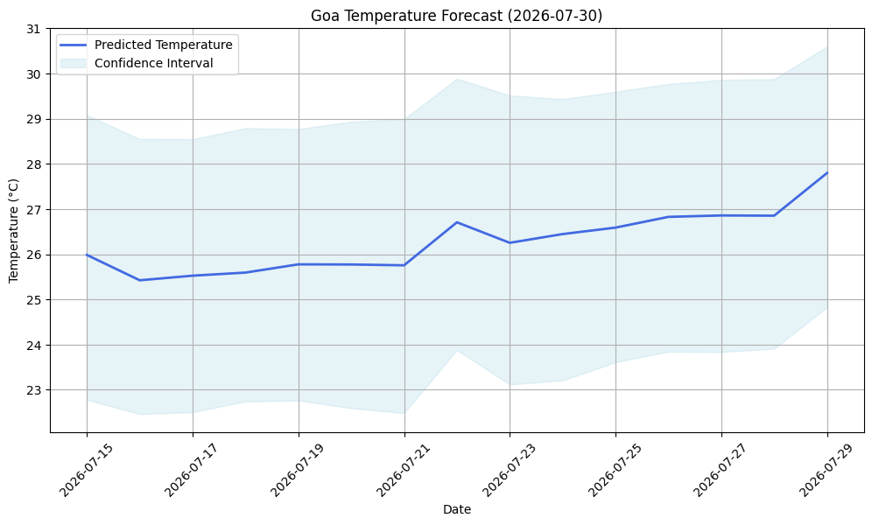
Page - 24
OVERVIEW OF MODEL OUTCOME
Weather Forecast : Temperature Forecast For Goa
Chart Type: Time Series Forecast Plot (Prophet Model)
Description: The chart presents the forecasted temperature trend for Goa. The blue line represents the predicted temperature, while the shaded region indicates the 95% confidence interval of the forecast.
Key Insights:
The forecast indicates a slight upward trend in temperature during the forecast period.
Predicted temperatures increase gradually from approximately 26°C to 28°C by 29 July 2026.
The forecast confidence interval remains relatively consistent.
No abrupt fluctuations or extreme temperature changes are predicted during the forecast period.
The forecast suggests that Goa is expected to maintain warm and stable weather conditions, consistent with its coastal climate.

Slide 25
Page - 25
FUTURE SCOPE
Key areas of future work include:
Improved Forecasting: Use advanced machine learning and deep learning models to improve the accuracy of weather and air quality predictions.
Scalable Data Storage: Enhance the system to collect and store environmental data at shorter time intervals using cloud-based infrastructure, enabling long-term analysis and better scalability.
Smart Alerts: Introduce real-time notifications for severe weather conditions and high pollution levels.
Enhanced Dashboard: Add more interactive filters and comparative visualizations for deeper environmental analysis.
Wider Accessibility: Develop a mobile application and support additional languages to make the platform accessible to a larger audience

Slide 26
CONCLUSION
Page - 26
ClimaSphere has been successfully developed as an interactive web-based platform for real-time weather and air pollution monitoring, environmental data analysis, and forecasting. By integrating modern web technologies, reliable APIs, data visualization, and machine learning, the system provides users with a comprehensive solution for monitoring environmental conditions and exploring historical trends. Its scalable architecture, user-friendly interface, and collaborative features make the platform suitable for researchers, students, environmental analysts, and the general public. Overall, the project demonstrates an effective application of data-driven technologies to support environmental awareness and informed decision-making.

Slide 27

Page - 27

